Slide 1

PROJECT ON
HOTEL BOOKING BOT BY USING AMAZON LEX,
AMAZON LAMBDA(PYTHON),TWILIO SERVICES
Under the Guidance of
Mrs. Sumana Bethala, APSSDC
Mr. Anil Kumar Varanasi, APSSDC
Presented by our Team
Villa Krupa Sagar, 22MH1A04J1
Losetty Surya Naga Anantha Swamy, 22MH1A04H4 Panuganti Rama Venkat,22MH1A04H8
Grandhi Sai Tanooj,22MH1A04G8
Parchuri Vineeth,23MH5A0415

Slide 2
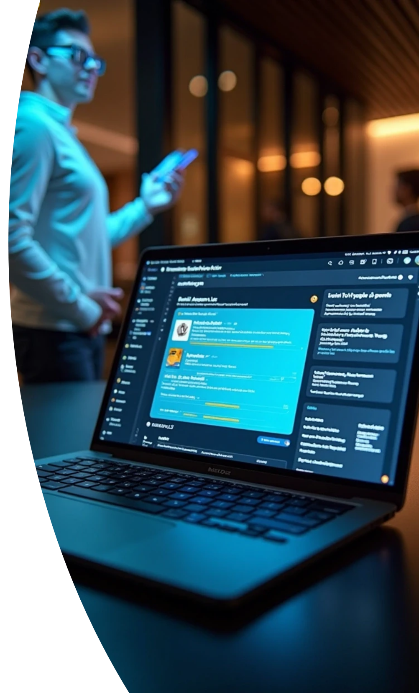
Hotel Booking Bot
This presentation explores the development of a hotel booking bot using Amazon Lex, AWS Lambda, and Twilio. It details the architecture, implementation, and benefits of integrating these technologies for streamlined hotel reservations.

Slide 3
Problem statement
In today’s fast-paced world, users seek convenient, quick, and reliable methods to book hotel rooms without the need to browse through multiple websites or make time-consuming phone calls.
Traditional hotel booking systems often lack real-time interaction and personalized assistance, leading to user dissatisfaction and booking drop-offs.
Solution overview
This project aims to address these challenges by developing an intelligent Hotel Booking Chatbot that enables users to interact and make hotel reservations through natural language conversations via Amazon Lex, process booking logic with AWS Lambda using Python, and communicate with users via Twilio SMS or WhatsApp services.

Slide 4
Introduction To Chatbots
User Experience Enhancement:
Definition And Purpose:
Growth In Hospitality:
Chatbots are AI-driven applications designed to simulate conversation with users, providing instant responses and assistance, enhancing customer service efficiency.
Chatbots offer 24/7 availability, personalized recommendations, and quicker response times, significantly improving the overall user experience in hotel bookings.
The hospitality industry increasingly adopts chatbots to improve customer interaction, streamline booking processes, and reduce operational costs.

Slide 5




Amazon Lex Overview
Integration with AWS Services
It seamlessly connects with other AWS services like Lambda for backend processing and DynamoDB for data storage, ensuring a robust solution.
2
Natural Language Processing
Amazon Lex utilizes advanced NLP to understand user intent, enabling more natural interactions between guests and the booking bot.
1
Multi-Platform Support
3
Lex supports integration across various platforms, including web applications and messaging services, facilitating widespread access for users.

Slide 6
AWS Lambda Functions And key Features
Scalability And Reliability:
Serverless Architecture:
Event-Driven Execution:
AWS Lambda allows the execution of code without provisioning servers, making it cost-effective and easier to manage for handling booking requests.
Lambda functions can be triggered by various events from Lex, processing user input and managing booking logic in real time.
The architecture automatically scales according to demand, ensuring reliable performance even during peak booking times.

Slide 7
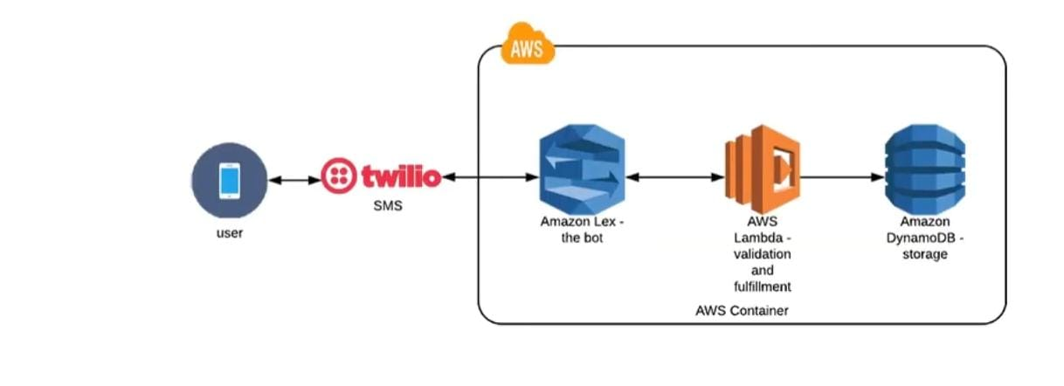
Architecture

Slide 8
Twilio Integration
Twilio enhances user interaction with SMS and voice capabilities, offering seamless communication, notifications, and voice commands for a more accessible booking process.
Communication Channel:
User Notifications:
Voice Interaction:
Twilio provides the infrastructure for sending and receiving SMS and voice calls, enhancing user interaction with the booking bot.
The bot can send booking confirmations, reminders, and updates through SMS, improving customer engagement and satisfaction.
Twilio's voice capabilities allow users to interact with the bot via voice commands, making the booking process more accessible.

Slide 9

Implementation Workflow
1
2
3
4
Backend Processing:
User Interaction:
Intent Recognition:
Response Delivery:
The user initiates a conversation with the bot via a chosen platform.
Amazon Lex processes the input to identify user intents and entities.
The bot delivers confirmation or information back to the user.
AWS Lambda handles the logic, queries databases, and processes requests.

Slide 10
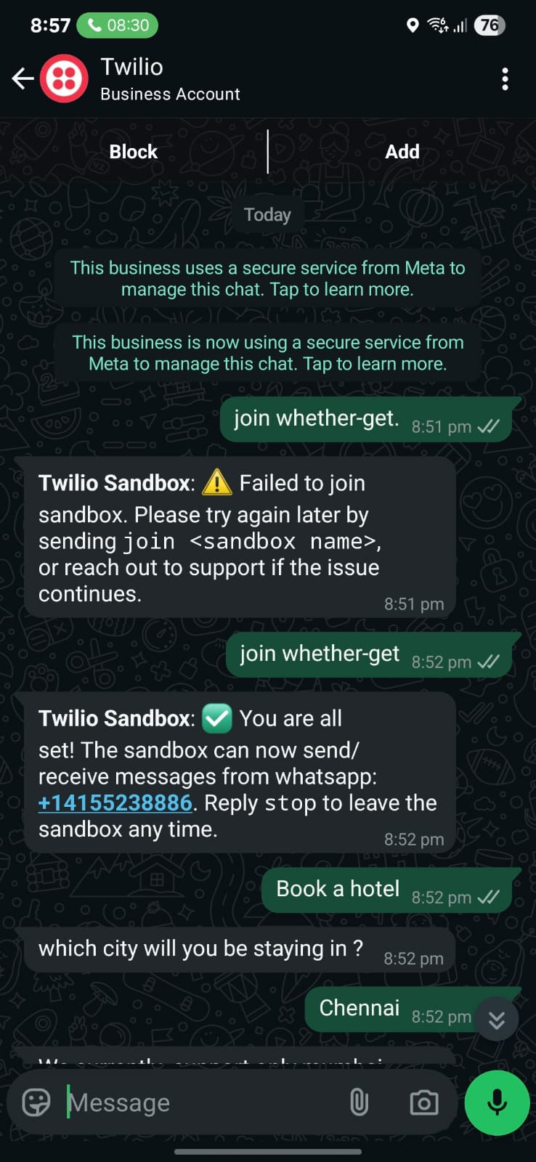
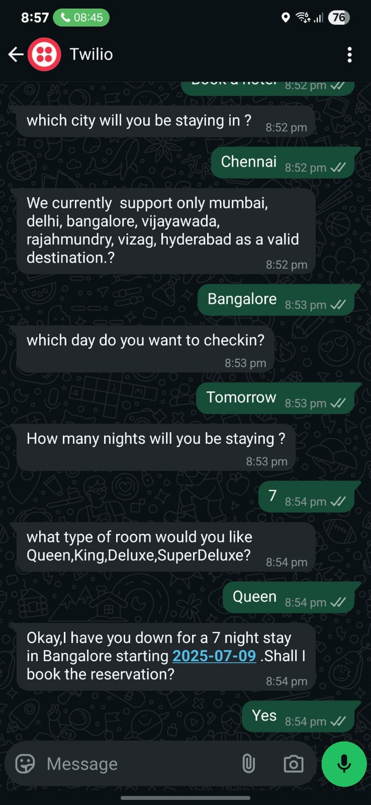
Outcomes

Slide 11
Benefits of the Bot
Cost Efficiency:
Increased Booking Rates:
Data Insights:
Automating the booking process reduces the need for human agents, leading to significant operational cost savings for hotels.
The bot collects valuable data on user preferences and behavior, enabling hotels to tailor their services and marketing strategies effectively.
The 24/7 availability of the bot encourages more bookings, as customers can make reservations at any time.

Slide 12
Conclusion and Future Work
Ongoing Improvements:
Expansion Possibilities:
Broader Applications:
Future integrations could include more payment options, loyalty programs, and additional communication channels for a more comprehensive user experience.
Continuous updates and enhancements to the bot will improve its functionality, including better NLP capabilities and more integrated services.
The technology and architecture used for the hotel booking bot can be adapted for other sectors, such as travel and retail, demonstrating its versatility.

